Slide 1
Analysis of LCP Mosquito Performance on Mitegen InSitu Plates
Shanshan Yu
Jan08, 2018

Slide 2
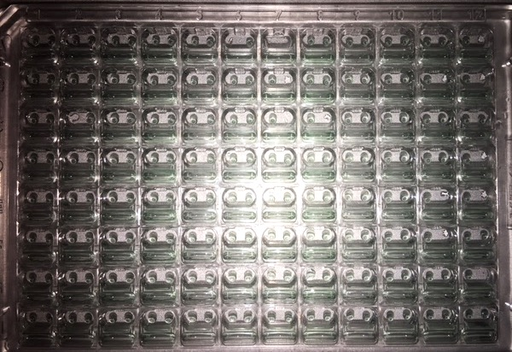
Missing Drop Count
Plates set up between Dec 19-23, 2017
Two sitting drop per well using a 3-drop sitting protocol
Left drop at position 1, right drop at position 3
Left drop missing count
(aggregation of 5 plates)
1 2 3 4 5 6 7 8 9 10 11 12 A 2 1 0 1 1 4 2 1 2 1 2 1 B 0 0 0 0 0 0 0 0 0 0 0 0 C 0 1 0 0 0 0 0 0 0 0 0 0 D 0 0 0 0 0 0 0 0 0 0 0 0 E 0 0 0 0 0 0 0 0 1 0 0 0 F 0 0 0 0 0 0 0 0 0 1 0 0 G 0 0 0 1 0 0 0 0 0 0 0 0 H 0 0 0 0 0 0 0 2 1 0 0 0
Plate # | Drop volume (ul) | Left drop | Right drop | Drop Ingredient
1 | 1.5 | 1 | 1 | PEG4K, water
2 | 1 | 1 | 1 | PEG4K, 10mg/ml lysozyme
3 | 1 | 1 | 1 | PEG6K, 10mg/ml lysozyme
4 | 1 | 1 | 1 | PEG4K, 10mg/ml lysozyme
5 | 1 | 1 | 1 | PEG6K, 10mg/ml lysozyme
Right drop missing count
(aggregation of 5 plates)
1 2 3 4 5 6 7 8 9 10 11 12 A 0 0 0 0 0 0 2 1 2 1 1 2 B 0 0 0 0 0 1 1 1 0 0 2 1 C 0 0 0 0 0 1 1 1 0 0 0 0 D 0 0 0 0 0 0 0 0 0 0 0 1 E 0 0 0 0 0 0 0 0 0 0 1 1 F 0 0 0 0 0 0 0 0 0 0 1 1 G 0 0 1 0 0 0 0 0 0 0 0 2 H 0 0 0 0 0 0 0 0 0 0 0 1
Plate 1
Red frame are the wells with one or two drops missing

Slide 3
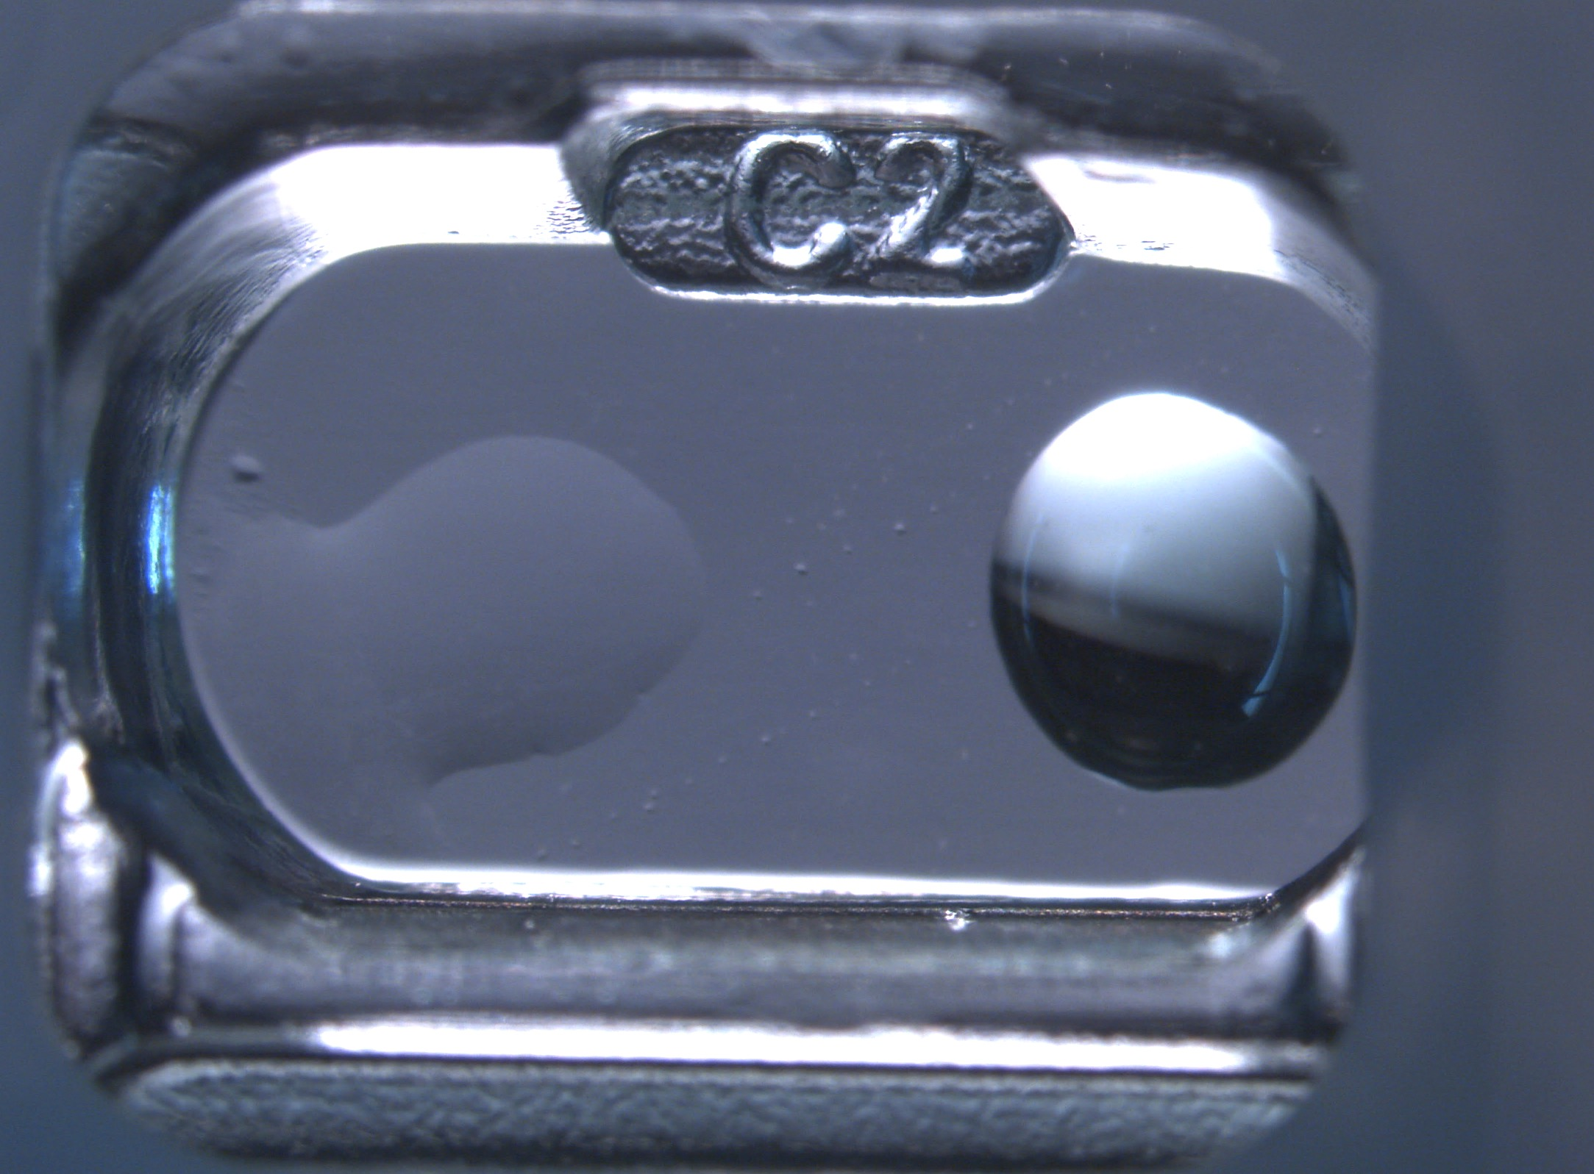
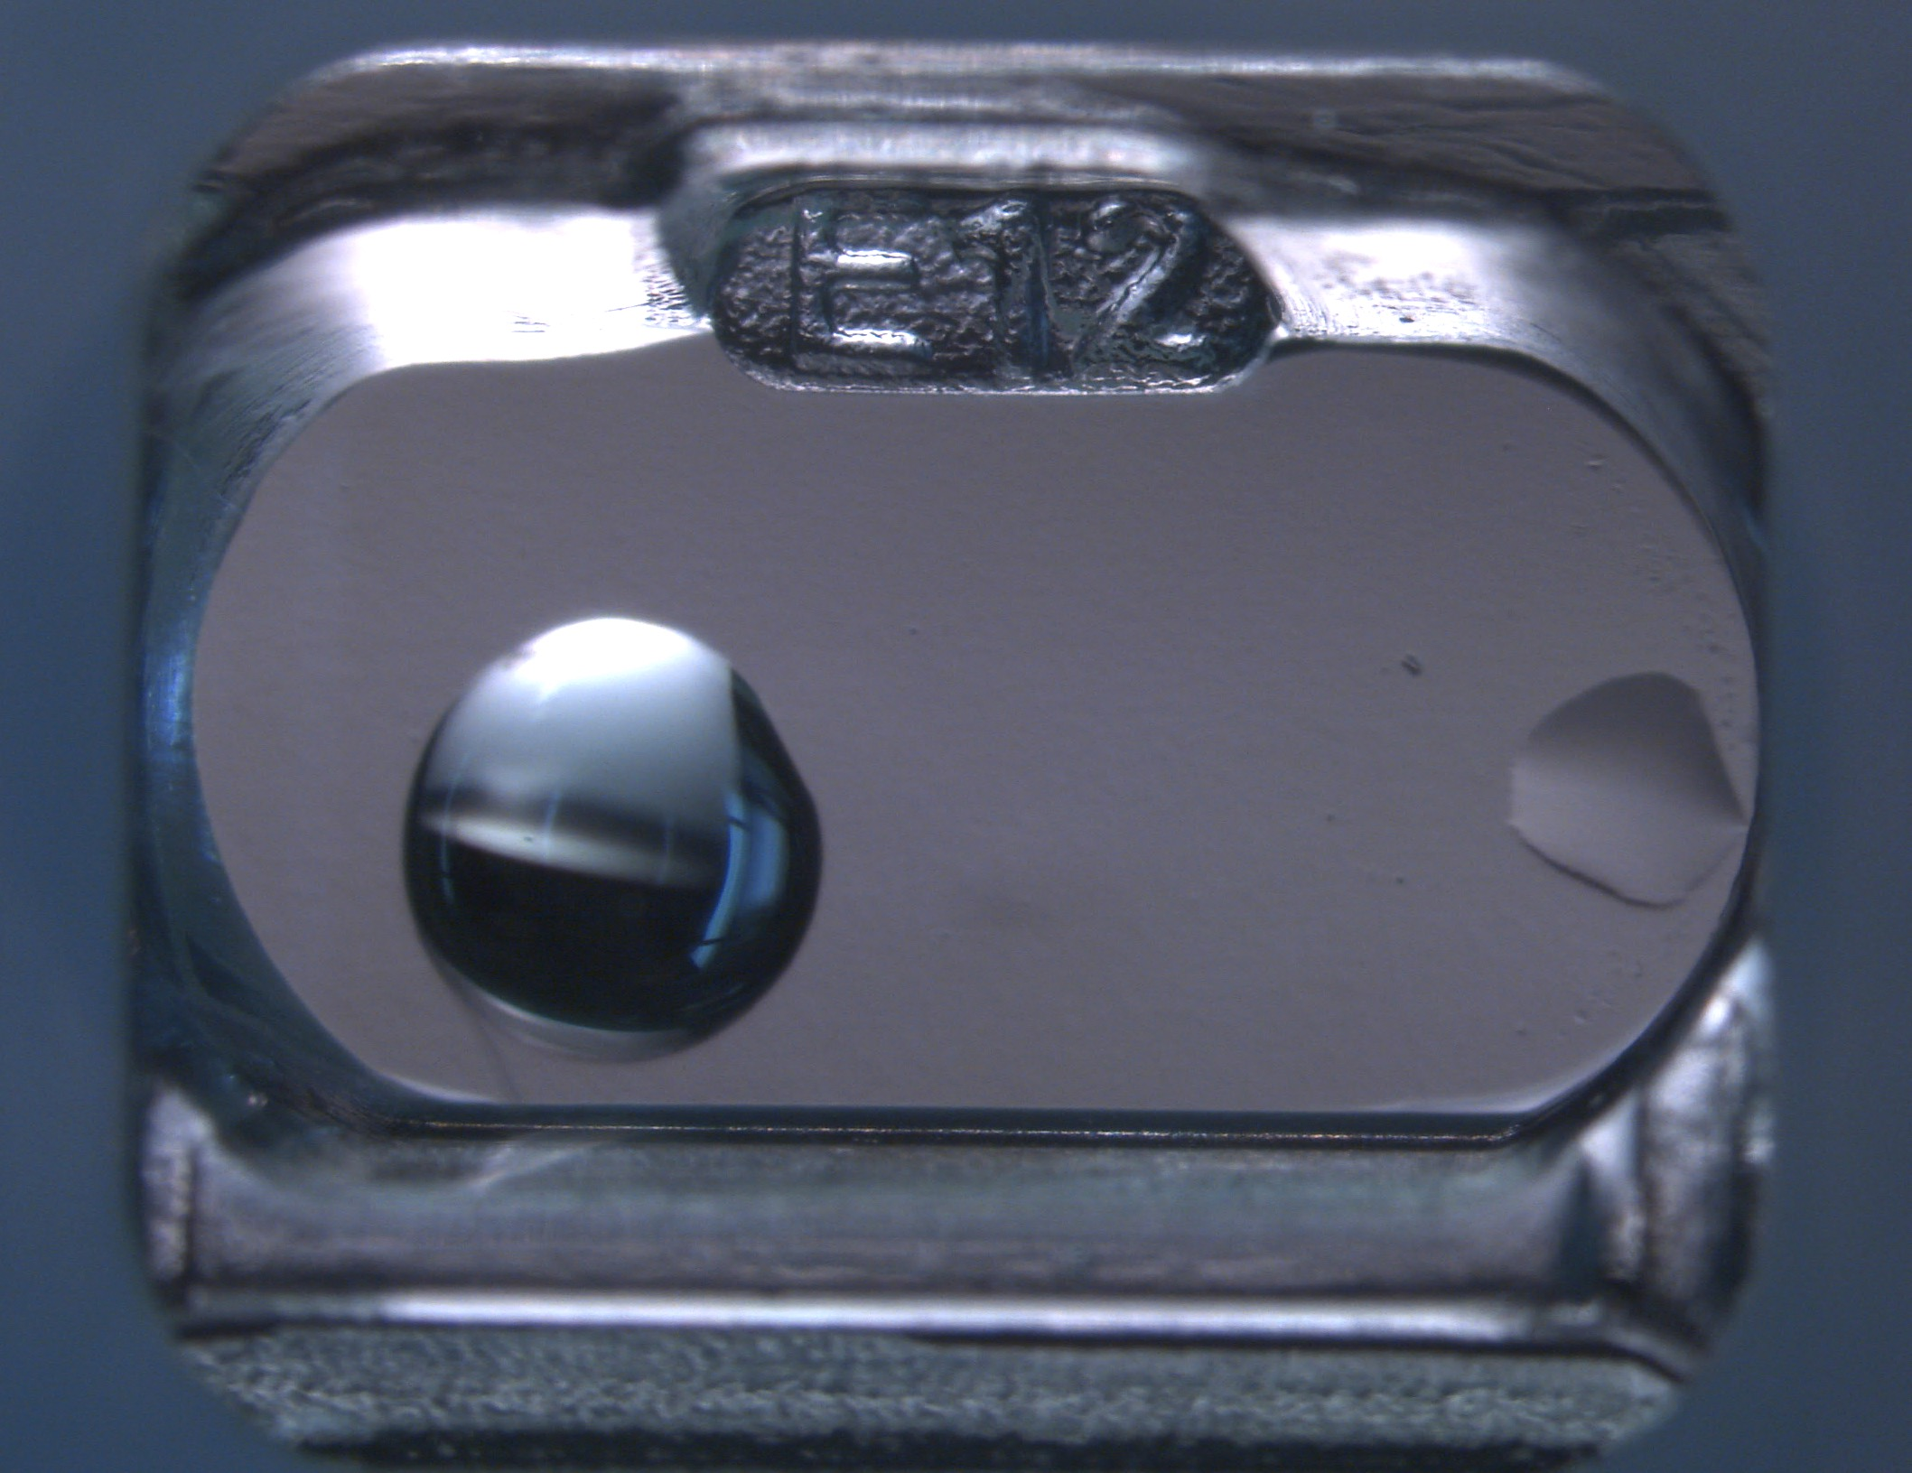
Missing Drop Close View
I suspect that the missing drops are because the distance between mosquito needles and walls of wells are too close. It could also because needles touched the walls during pipetting.
Plate 1,
red frame are the wells C2 and E12
The views of two wells with missing drops under a microscope

Slide 4
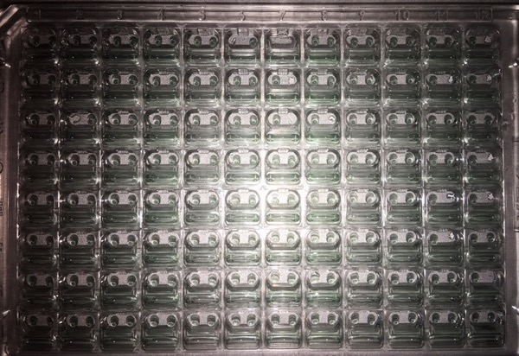
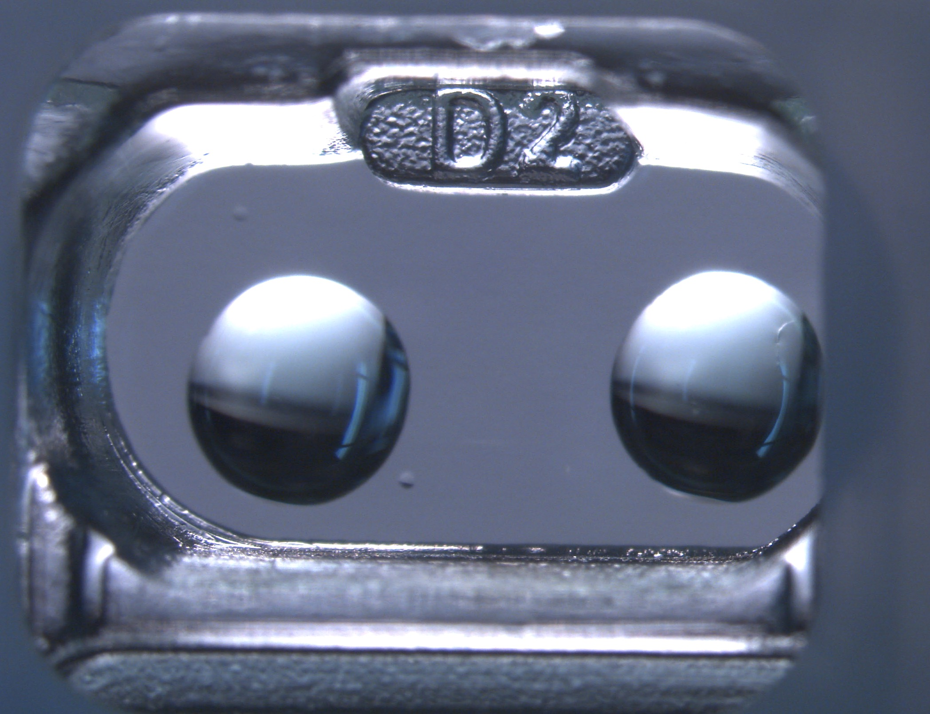
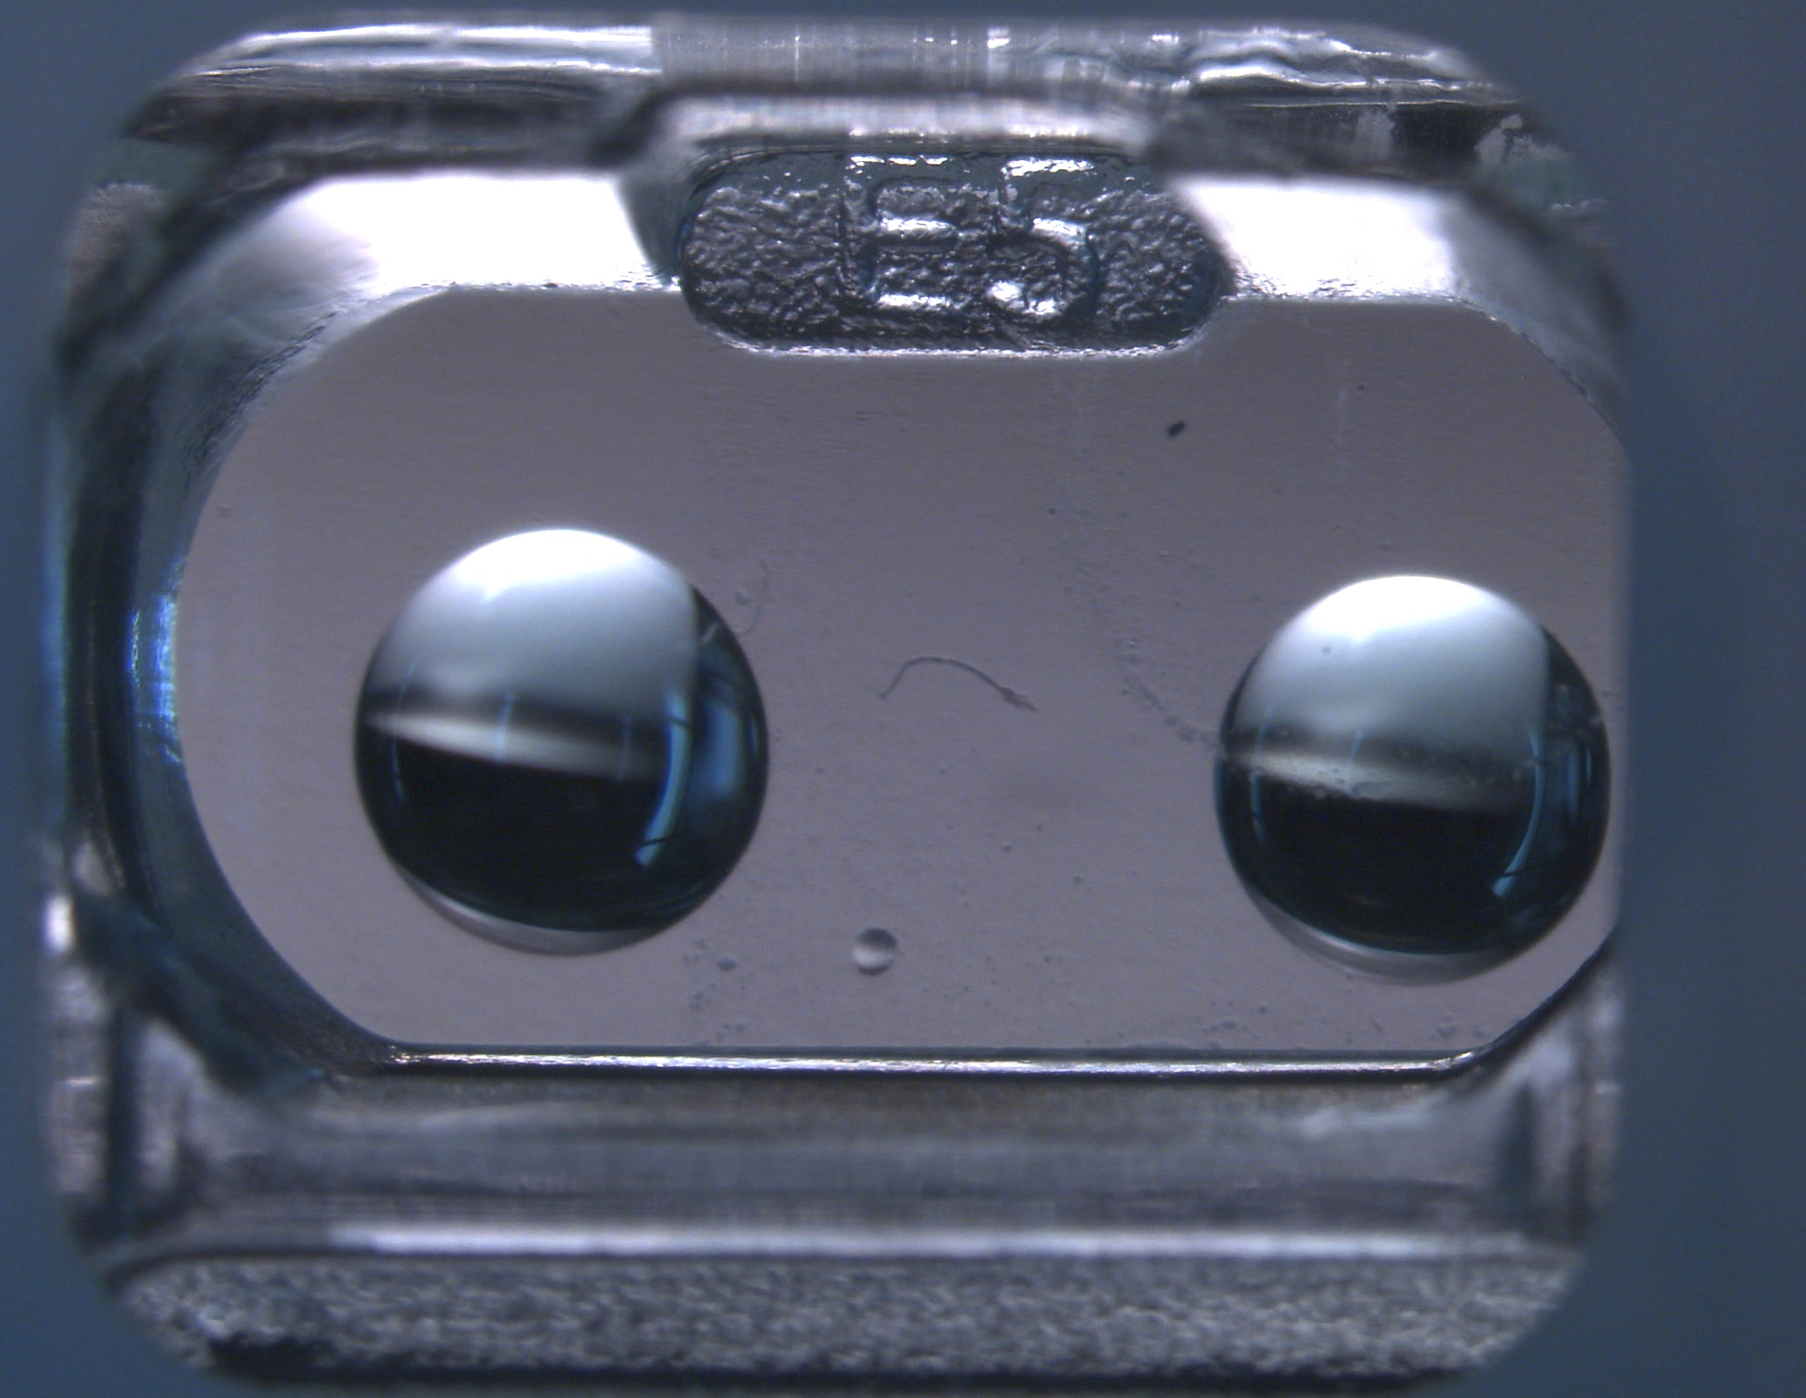
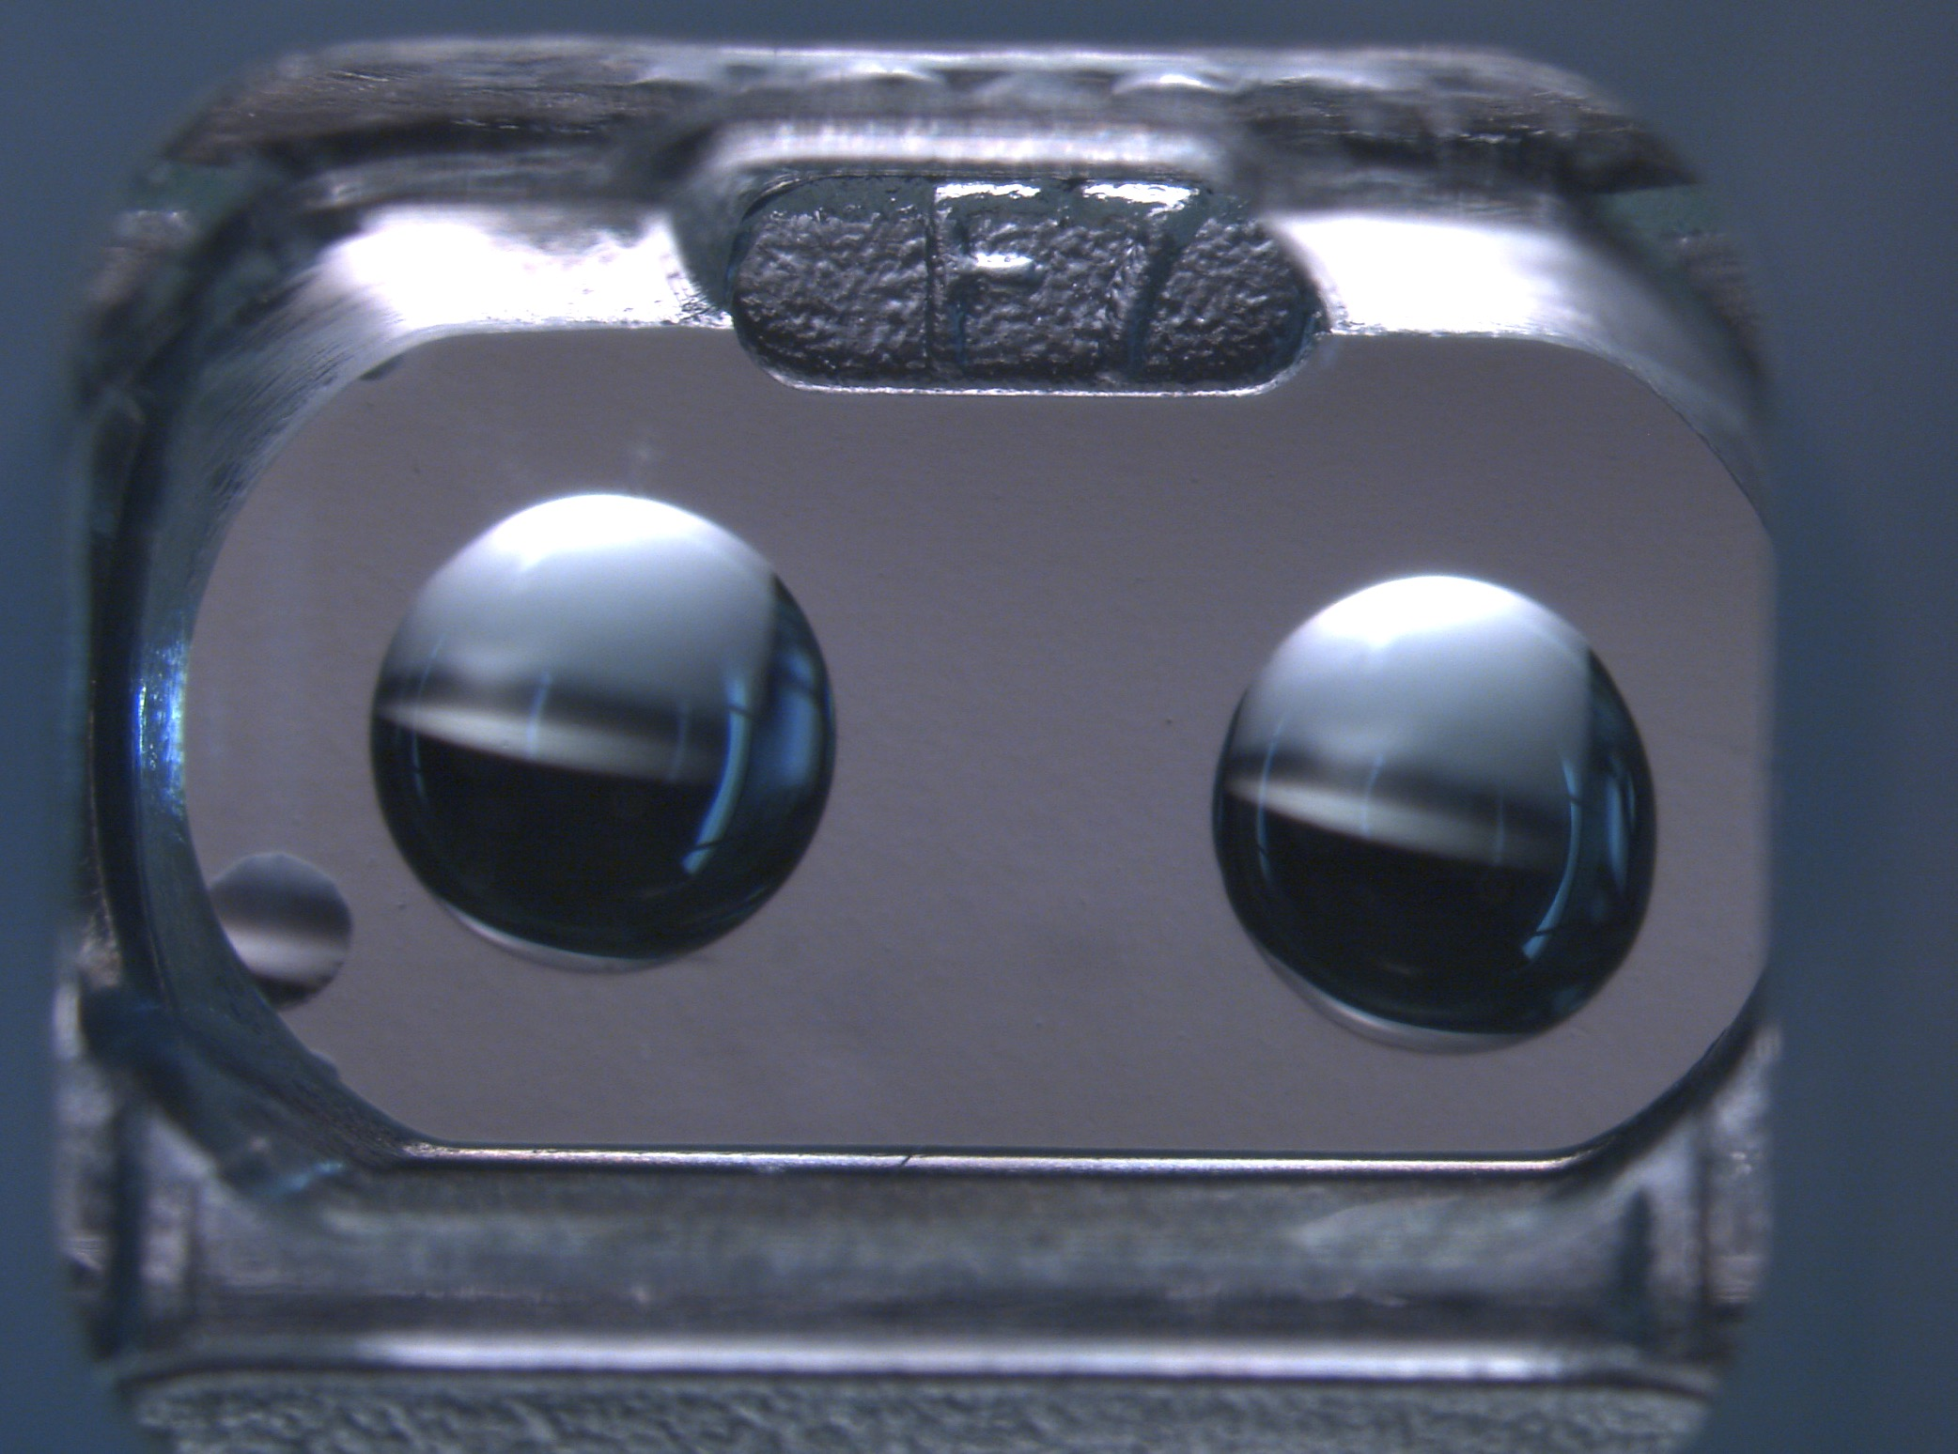
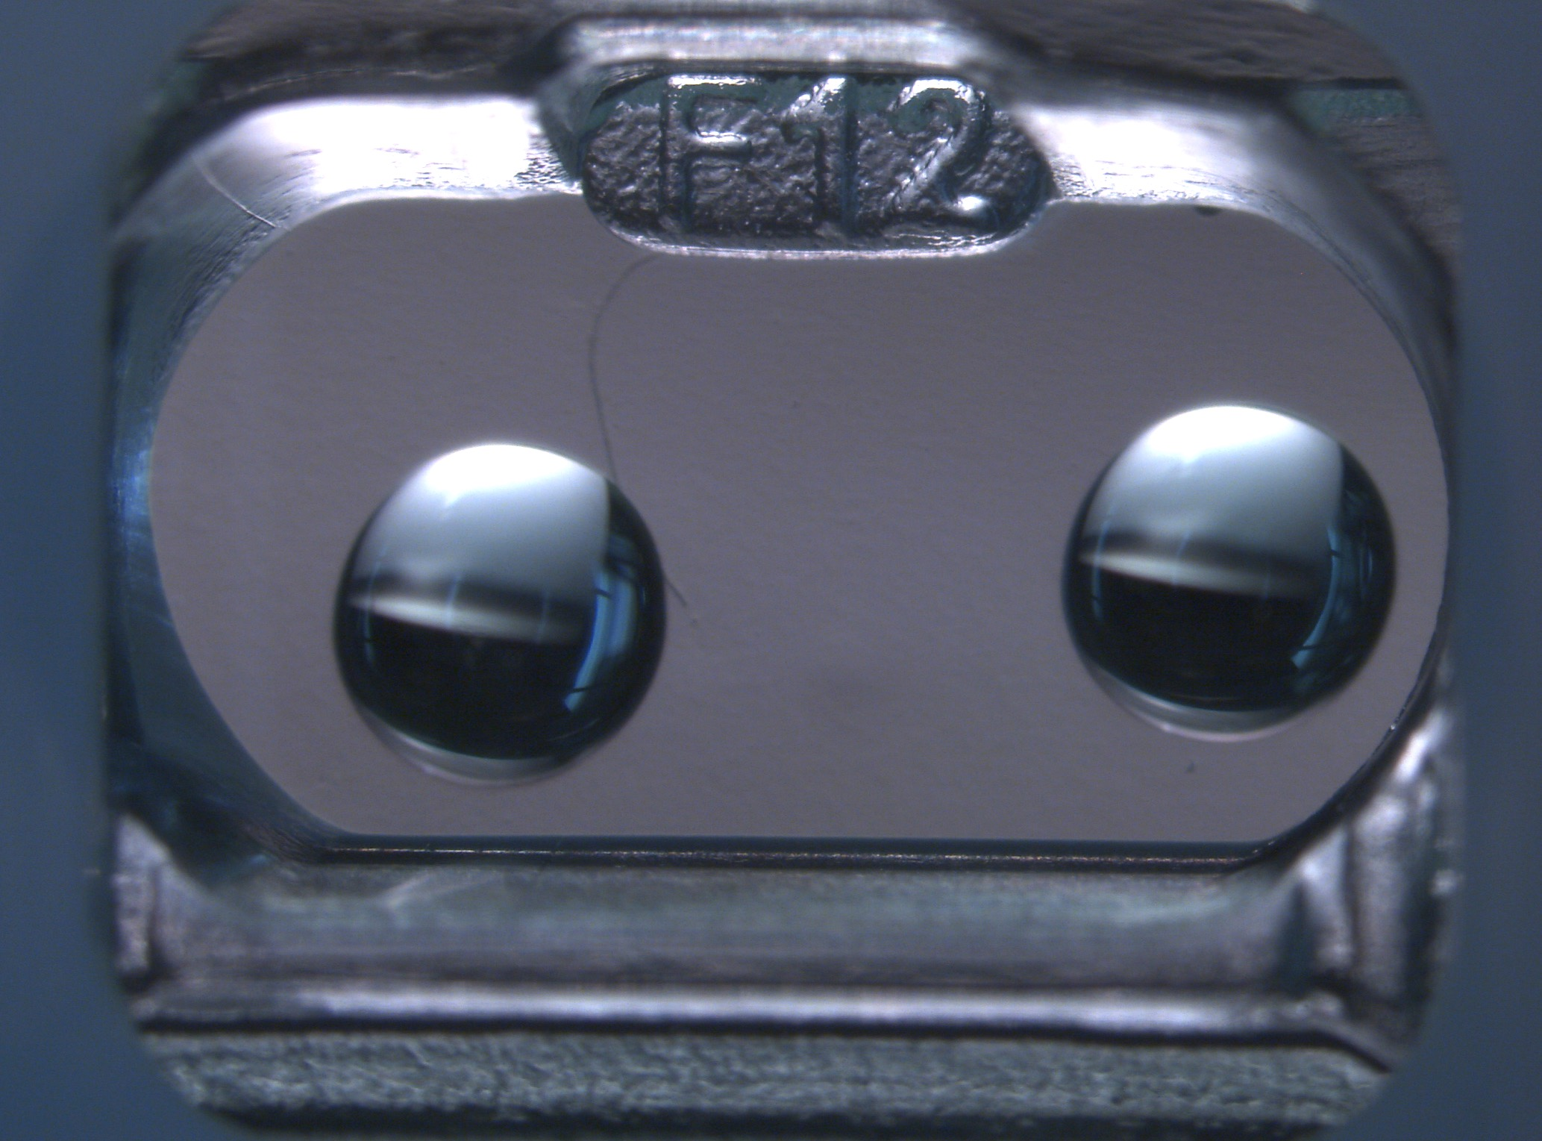
Other Drop Close View
The distances between two drops look good, but both of them are still close to the walls inside wells. Could the two drops be adjusted to be a little further away from walls?
The view of four wells with both sitting drops
Plate 1

Slide 5
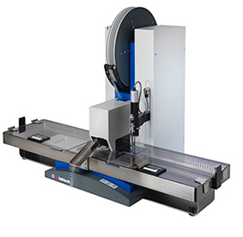
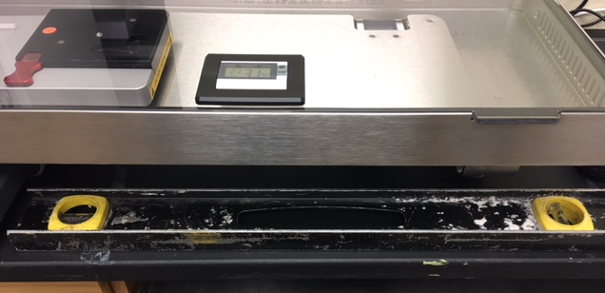
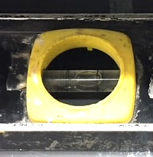
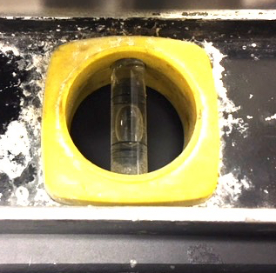
LCP mosquito bench surface is horizontal
1️⃣⃣⃣
The level was On bench, under the humidity chamber
3️⃣⃣⃣⃣⃣
y axis
y-axis
2️⃣⃣⃣⃣
x axis
x-axis
1️⃣⃣⃣
y-axis
1, 2, 3 are three positions that are measured by a level
x-axis

Slide 6
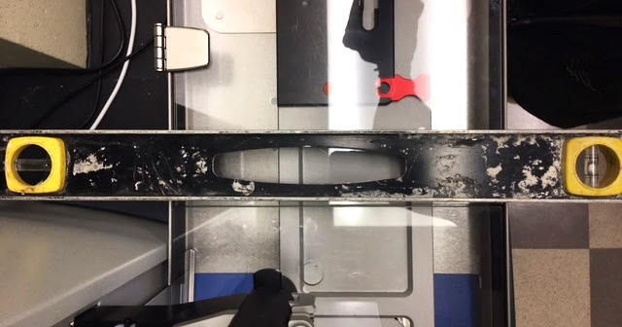
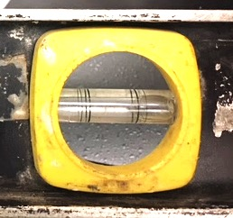
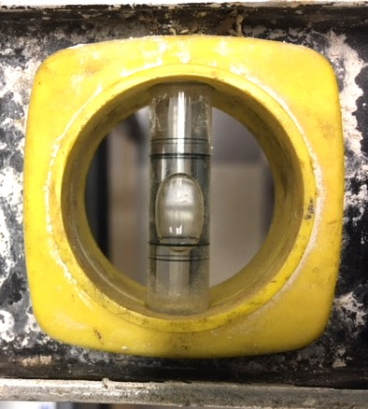
LCP mosquito plate deck titles towards the back
The level was on top of the humidity chamber frame, right hand side to the LCP syringe
2️⃣⃣⃣⃣
3️⃣⃣⃣⃣⃣
y axis
y axis
2️⃣⃣⃣⃣
x axis
1️⃣⃣⃣
1, 2, 3 are three positions that are measured by a level
The bubble sit at the bottom, indicating the y-axis not horizontal
x axis

Slide 7
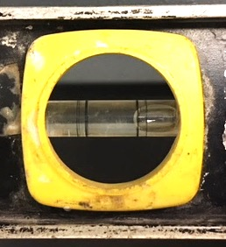
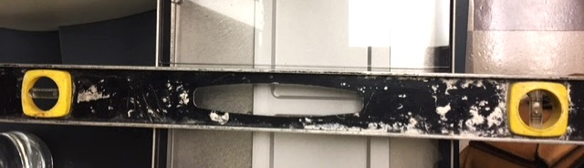
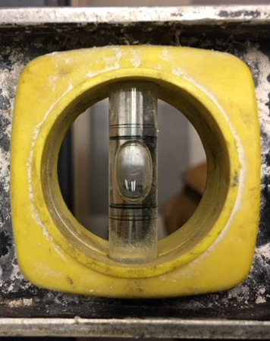
LCP mosquito plate deck titles towards the back
3️⃣⃣⃣⃣⃣
The level was on top of the humidity chamber frame, left hand side to the pipetting head
y axis
3️⃣⃣⃣⃣⃣
y axis
2️⃣⃣⃣⃣
x axis
1️⃣⃣⃣
1, 2, 3 are three positions that are measured by a level
The bubble sit at the bottom, indicating the y-axis not horizontal
x axis

